Slide 1
Machine Learning AIML CZG565
M4 : Linear Models for Classification
Course Faculty of MTech Cluster
BITS – CSIS - WILP

Slide 2

Machine Learning
Disclaimer and Acknowledgement
These content of modules & context under topics are planned by the course owner Dr. Sugata, with grateful acknowledgement to many others who made their course materials freely available online
We here by acknowledge all the contributors for their material and inputs.
We have provided source information wherever necessary
Students are requested to refer to the textbook w.r.t detailed content of the presentation deck shared over canvas
We have reduced the slides from canvas and modified the content flow to suit the requirements of the course and for ease of class presentation
Slide Source / Preparation / Review:
From BITS Pilani WILP: Prof.Sugata, Prof.Chetana, Prof.Rajavadhana, Prof.Monali, Prof.Sangeetha, Prof.Swarna, Prof.Pankaj
External: CS109 and CS229 Stanford lecture notes, Dr.Andrew NG and many others who made their course materials freely available online

Slide 3
Agenda
Discriminant Functions
Probabilistic Generative Classifiers
Probabilistic Discriminative Classifiers
Logistic Regression
Applications : Text classification model

Slide 4
Decision Theory & Objective of Classification Models

Slide 5
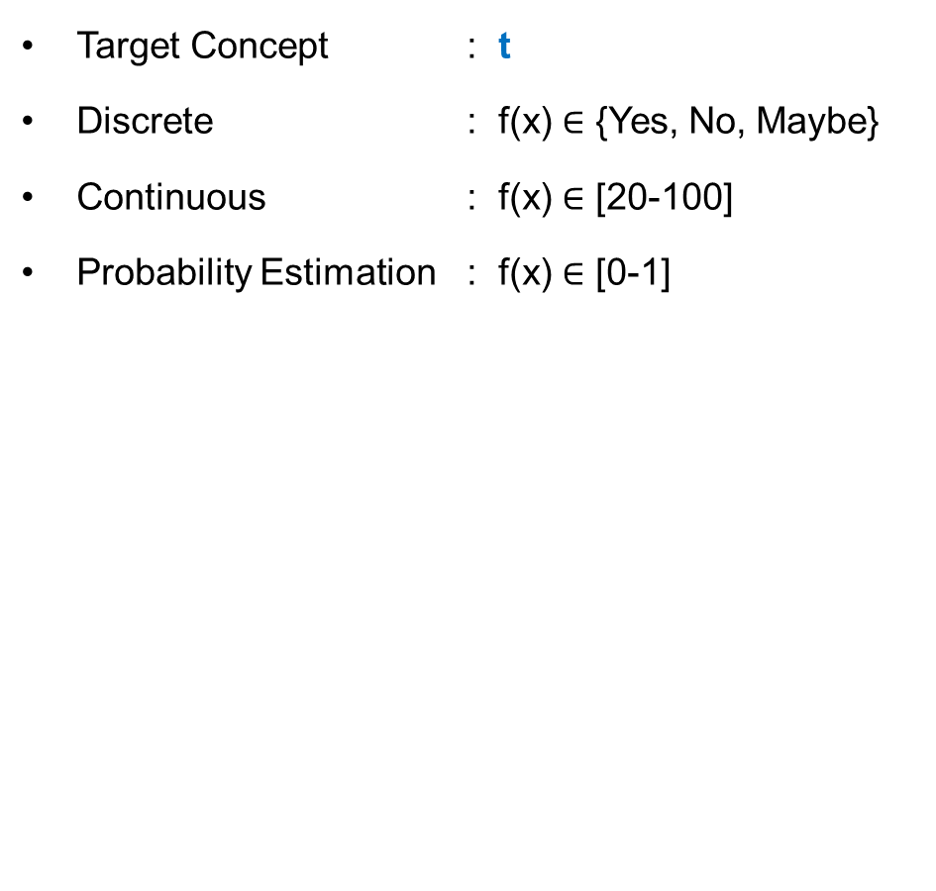
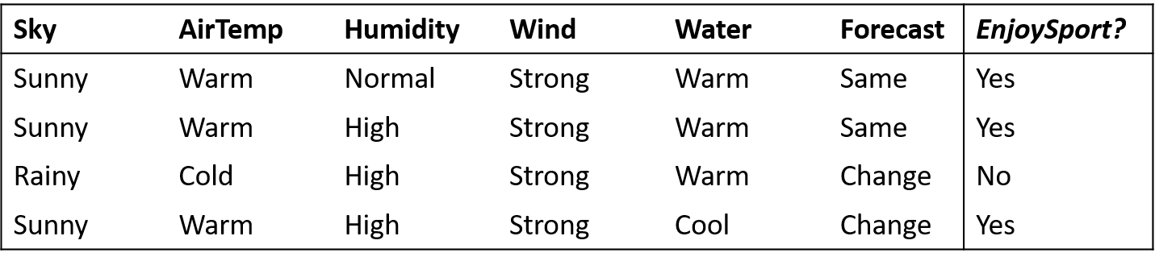
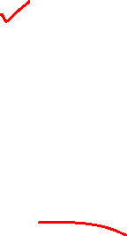
Inductive Learning Hypothesis : Interpretation
Classification
Regression

Slide 6
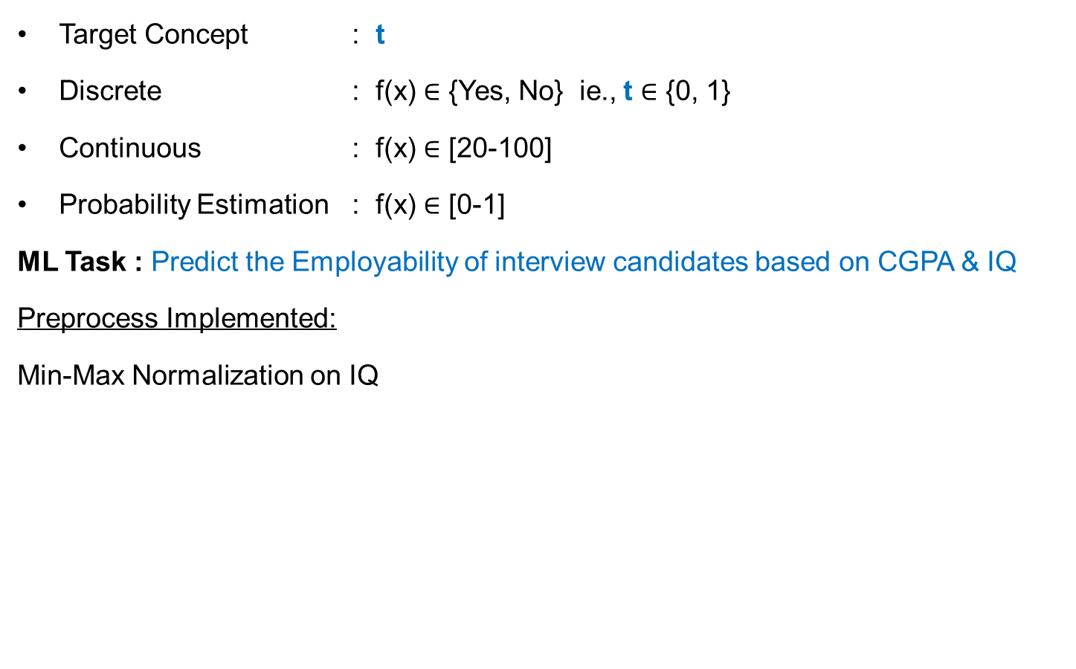
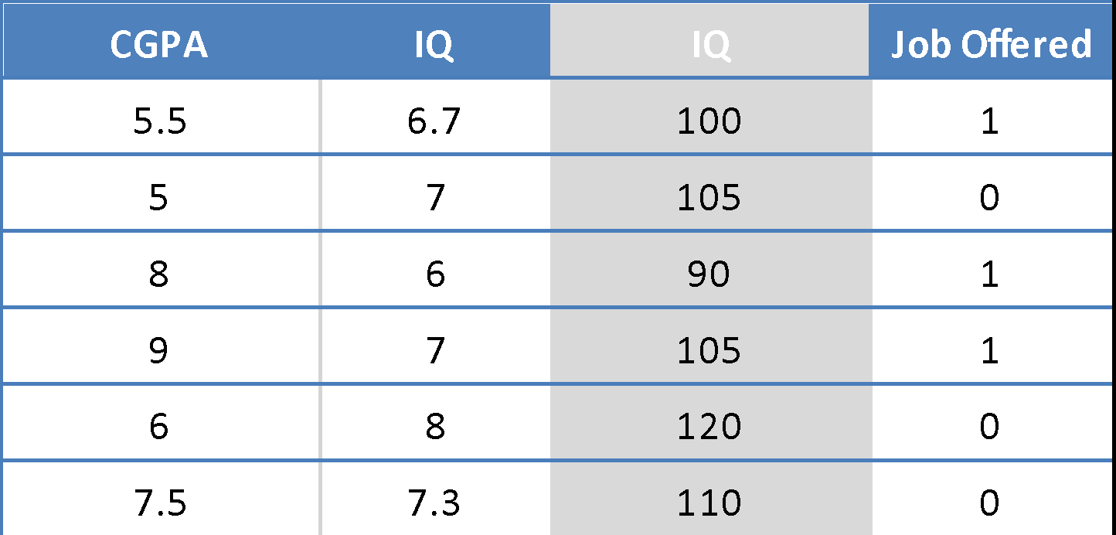
Decision Theory
Binary Classification

Slide 7
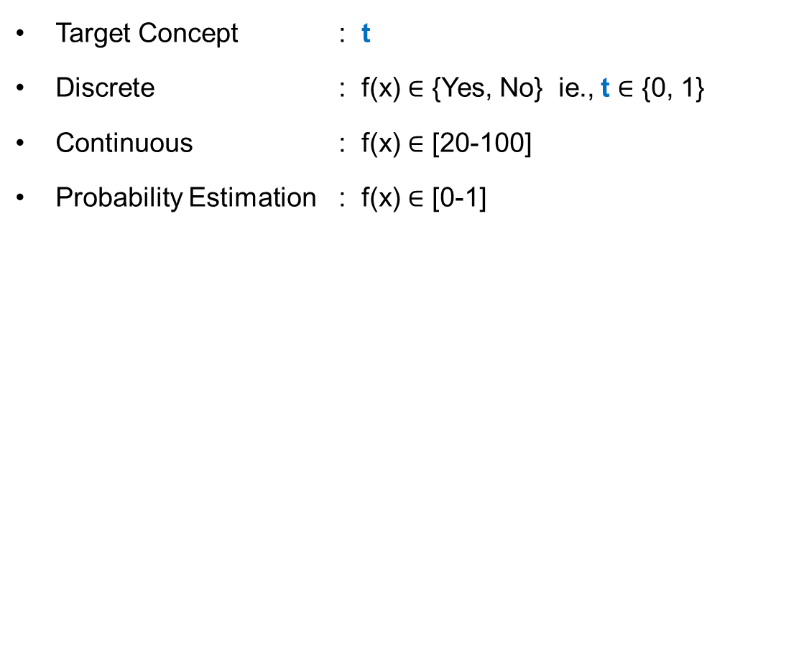
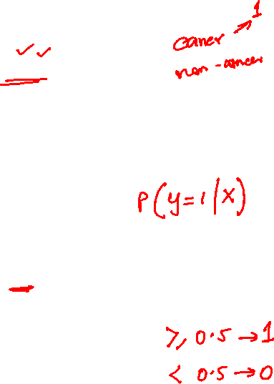
Decision Theory : The decision problem: given x, predict t according to a probabilistic model p(x, t)
p(x, C_{k}) is the (central!) inference problem
P(Job = 1)
0.8
0.4
0.75
0.95
0.35
0.4
X =< , , > 🡪 = P(C_{k}| X)

Slide 8
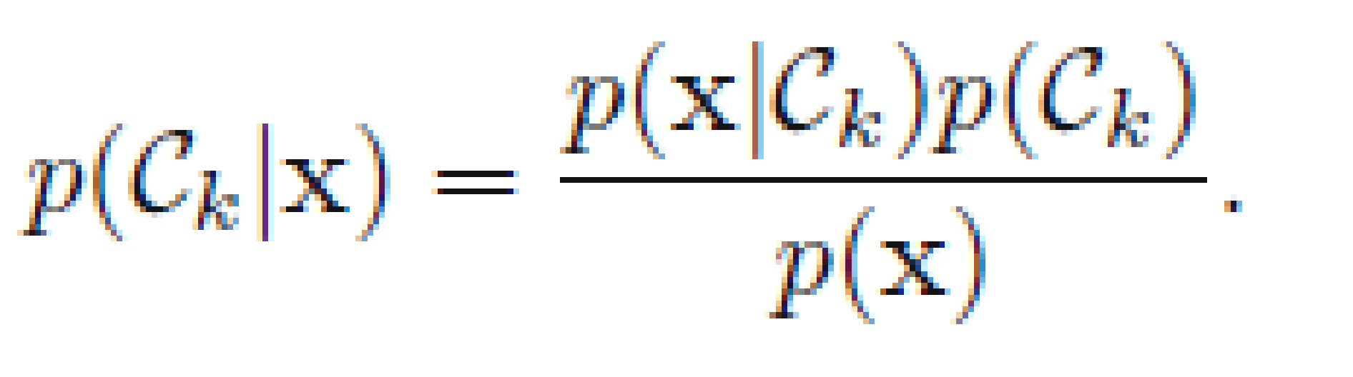

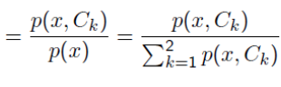

Classification Problem: Stages
CPGA | IQ | Job - Offered
5.5 | 6.7 | 1
5 | 7 | 0
8 | 6 | 1
9 | 7 | 1
6 | 8 | 0
7.5 | 7.3 | 0
Learning
algorithm
Induction/ Inference step
Learn
Model for
p(x,C_{k})
p(x,C_{job=1}) & p(x,C_{job =0})
Training Set
Model
Apply Model to find
optimal t
CPGA | IQ | Job - Offered
3 | 4 | ?
7 | 6 | ?
5.5 | 8 | ?
Deduction/
Decision Step
Test Set

Slide 9
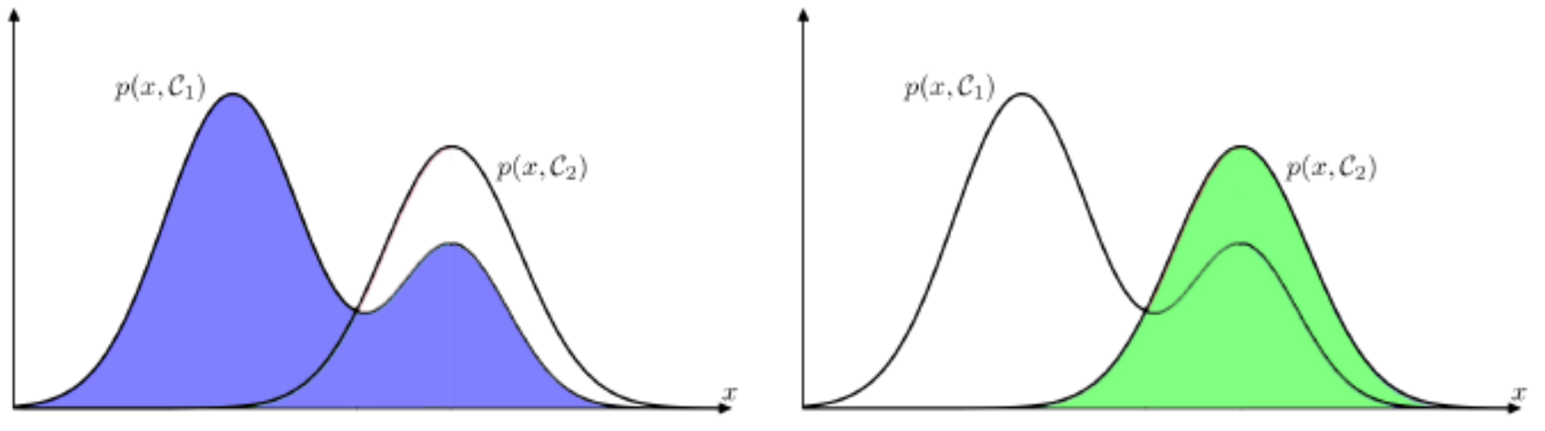
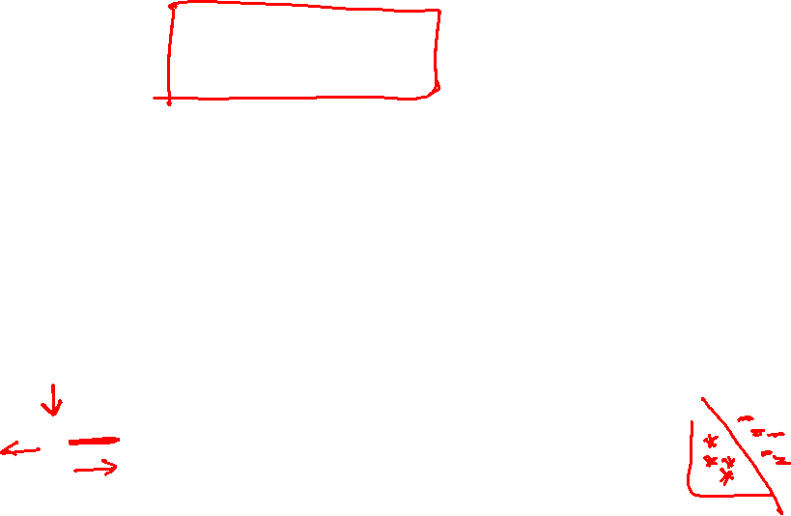
Decision Region
Sample Rule / Hypothesis:
IF CGPA<7 Job = 1
Else Job = 0
Training Set
CPGA | IQ | Job - Offered
5.5 | 6.7 | 1
5 | 7 | 0
8 | 6 | 1
9 | 7 | 1
6 | 8 | 0
7.5 | 7.3 | 0
Model divides the input space into regions R_{k} called decision regions, one for each class, such that all points in R_{k} are assigned to class C_{k}
Learning
algorithm
A mistake occurs when an input vector belonging to class C₁ is assigned to class C₂
Induction/ Inference step
Learn
Model for
p(x,C_{k})
Probability
Probability
Model
CGPA = 7
CGPA = 7
Prob.Dist for Job = 1
Prob.Dist for Job = 0
CGPA
CGPA

Slide 10
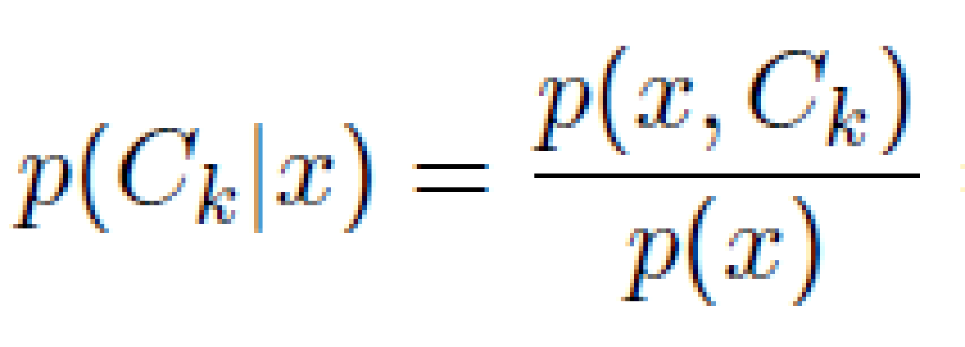
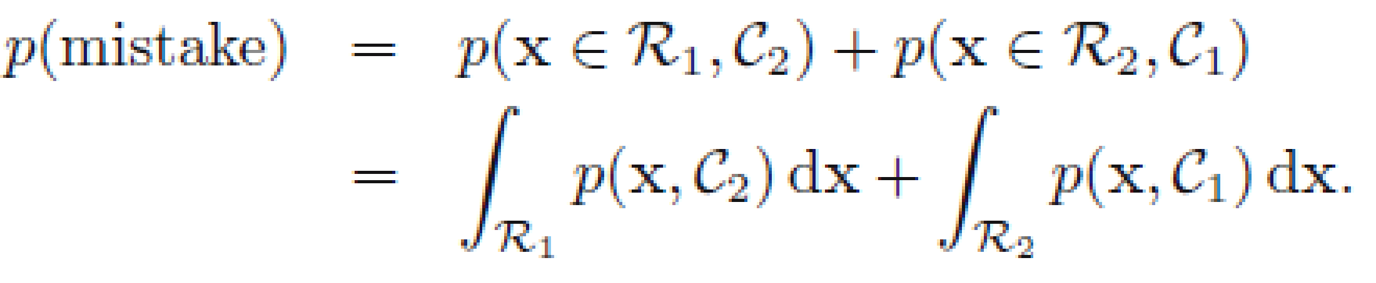
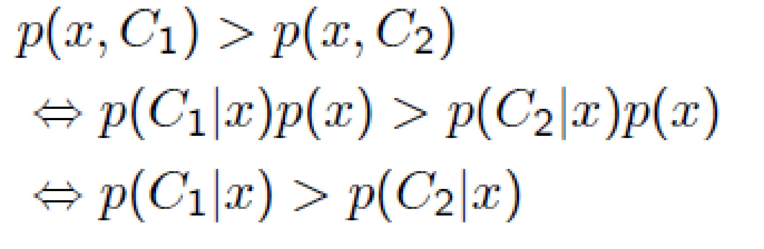
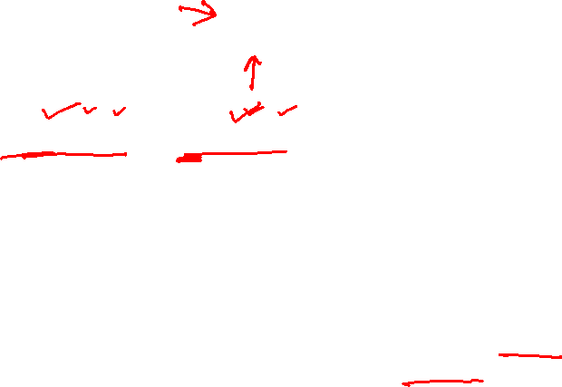
Misclassification Rate
To minimize p(mistake), each x is assigned to whichever class has the smaller value of the integrand
The minimum probability of making a mistake is obtained if each value of x is assigned to the class for which the posterior probability p(C_{k}|x) is largest.

Slide 11
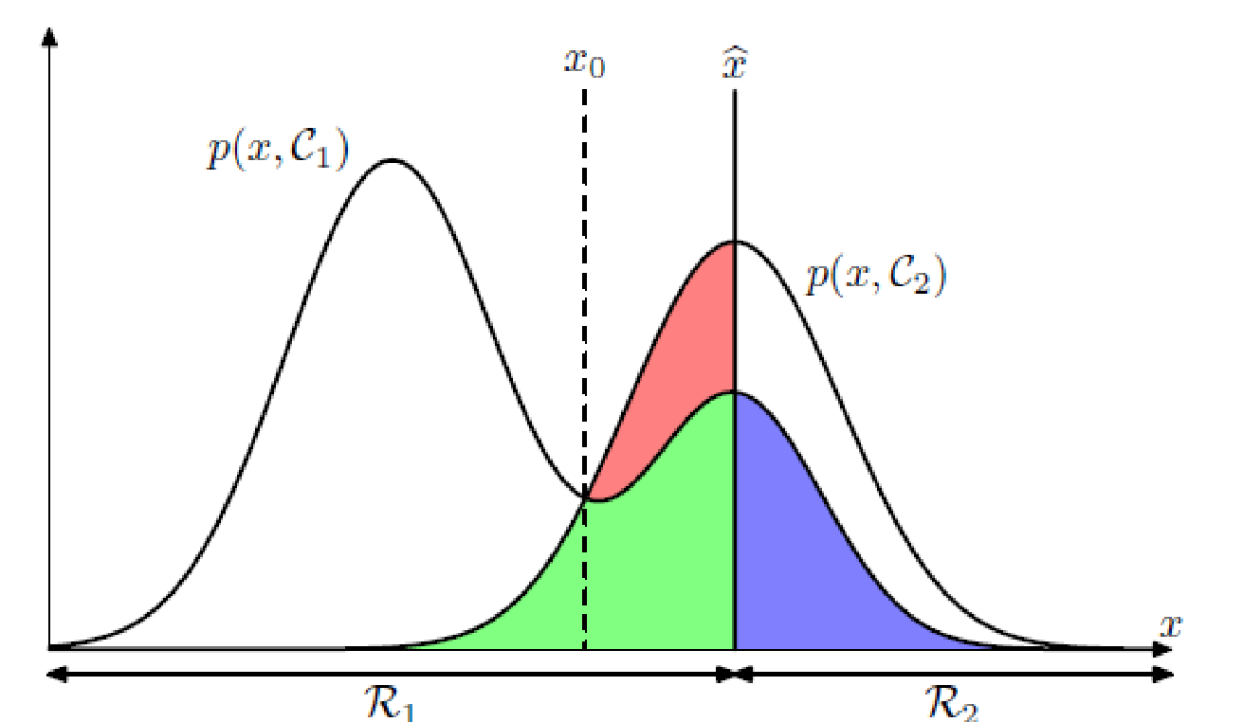
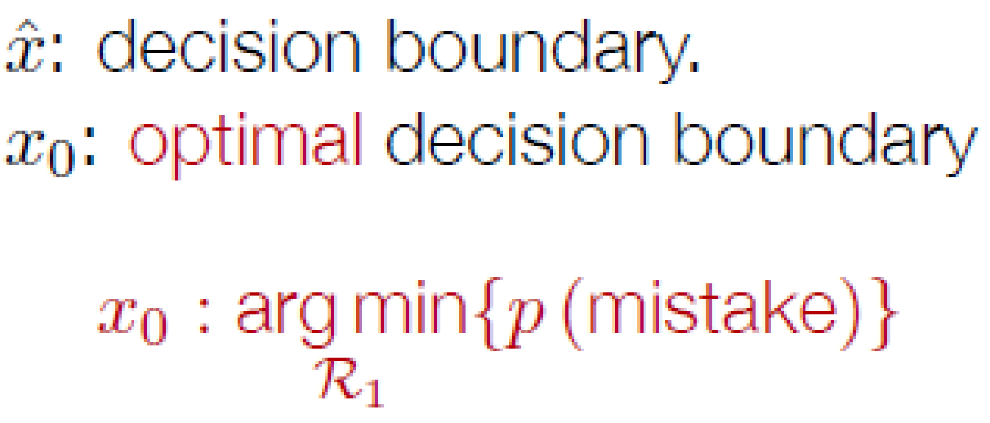

Decision Theory - Summary
Probability
CGPA = 7
CGPA = 8
CGPA

Slide 12
Linear Models for Classification

Slide 13
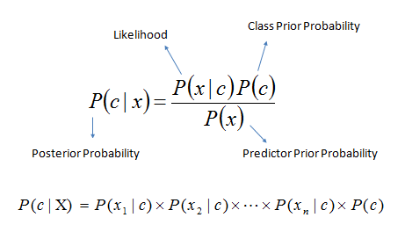
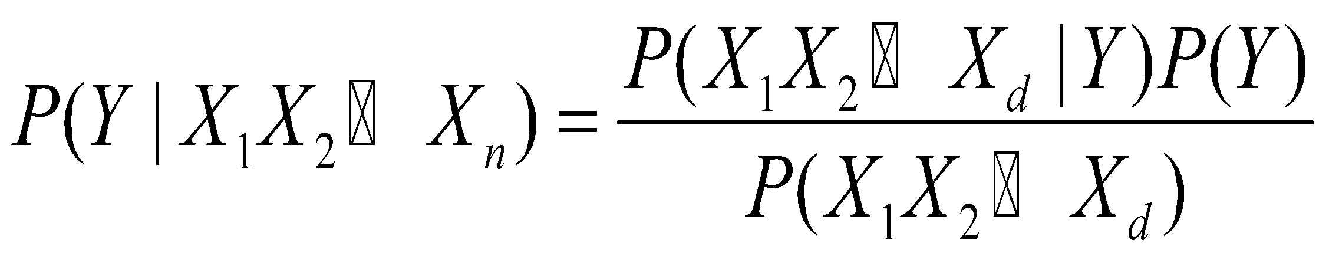
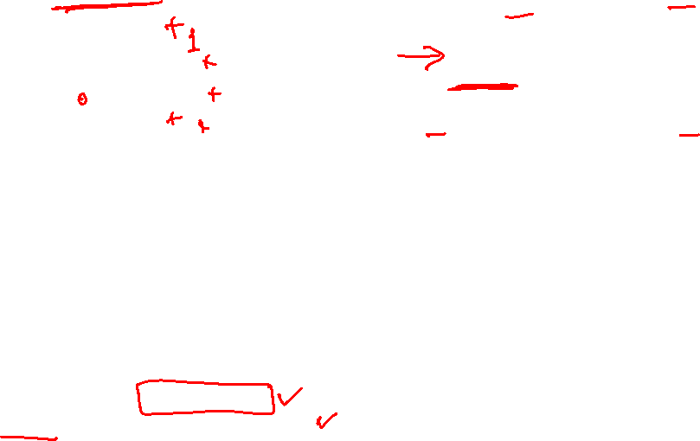
Types of Classification Decision Theory: Interpretation Model Building
Generative
IQ
x₂
CGPA
x_{1c}
CPGA | IQ | Job - Offered
5.5 | 6.7 | 1
5 | 7 | 0
8 | 6 | 1
9 | 7 | 1
6 | 8 | 0
7.5 | 7.3 | 0
… | …. | …..
Known as generative models, because by sampling from them it is possible to generate synthetic data points in the input space.
Eg.,Classification: Naïve Bayes,
Clustering : Mixtures of Gaussians

Slide 14
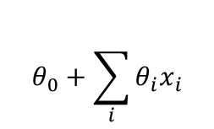
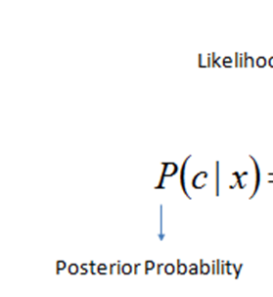
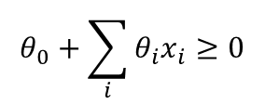
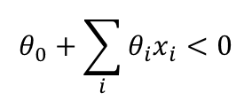

Types of Classification Decision Theory: Interpretation Model Building
Discriminative
y=1
IQ
x₂
Decision Boundary
y=0
CGPA
x₁
CPGA | IQ | Job - Offered
5.5 | 6.7 | 1
5 | 7 | 0
8 | 6 | 1
9 | 7 | 1
6 | 8 | 0
7.5 | 7.3 | 0
… | …. | …..
Logistic regression, SVMs , tree based classifiers (e.g. decision tree) Traditional neural networks, Nearest neighbor

Slide 15
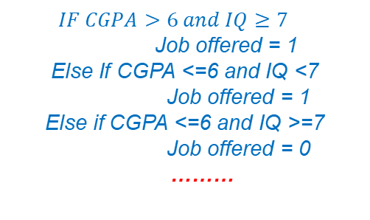

Types of Classification Decision Theory: Interpretation Model Building
CGPA
>6 <=6
<7 >=7 >=7 <7
IQ
IQ
Label 0
Label 1
Label 0
Label 1
CPGA | IQ | Job - Offered
5.5 | 6.7 | 1
5 | 7 | 0
8 | 6 | 1
9 | 7 | 1
6 | 8 | 0
7.5 | 7.3 | 0
… | …. | …..
Logistic regression, SVMs , tree based classifiers (e.g. decision tree) Traditional neural networks, Nearest neighbor

Slide 16
Logistic Regression

Slide 17

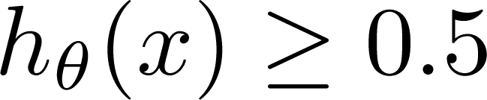
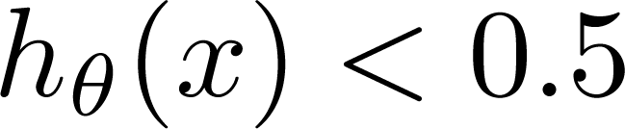
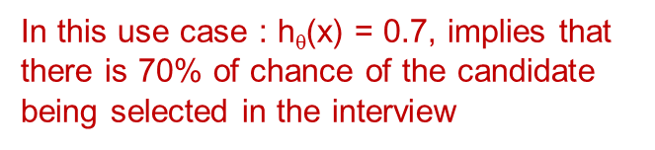
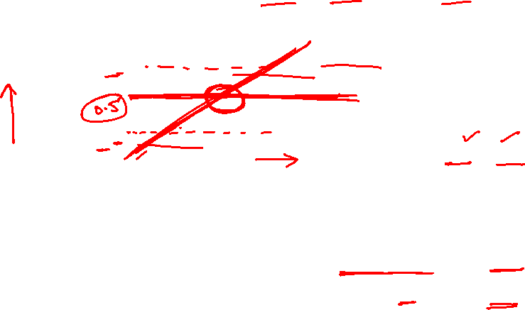
Job Offered ?
Logistic Regression vs Least Squares Regression
Figure depicts sample data points
(Yes) 1
(No) 0
CGPA or IQ
Independent Attribute : CGPA or IQ
Can we solve the problem using linear regression? E.g., fit a straight line and define a threshold at 0.5
Threshold classifier output h_{θ}(x) at 0.5:
A Discriminant function f (x)
directly map input to class labels
In two-class problem, f (.) is binary valued
If
If
, predict “y = 1”
, predict “y = 0”

Slide 18
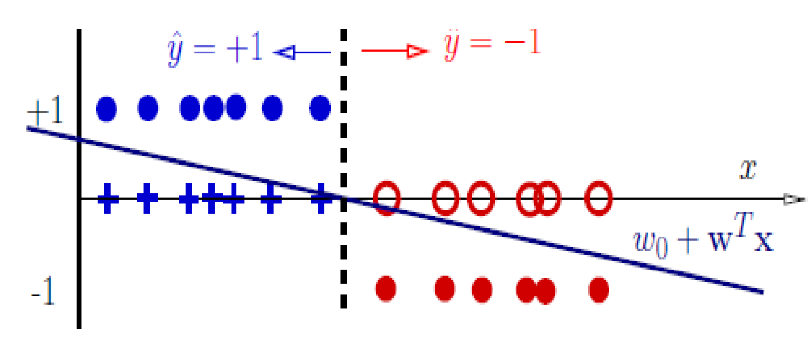
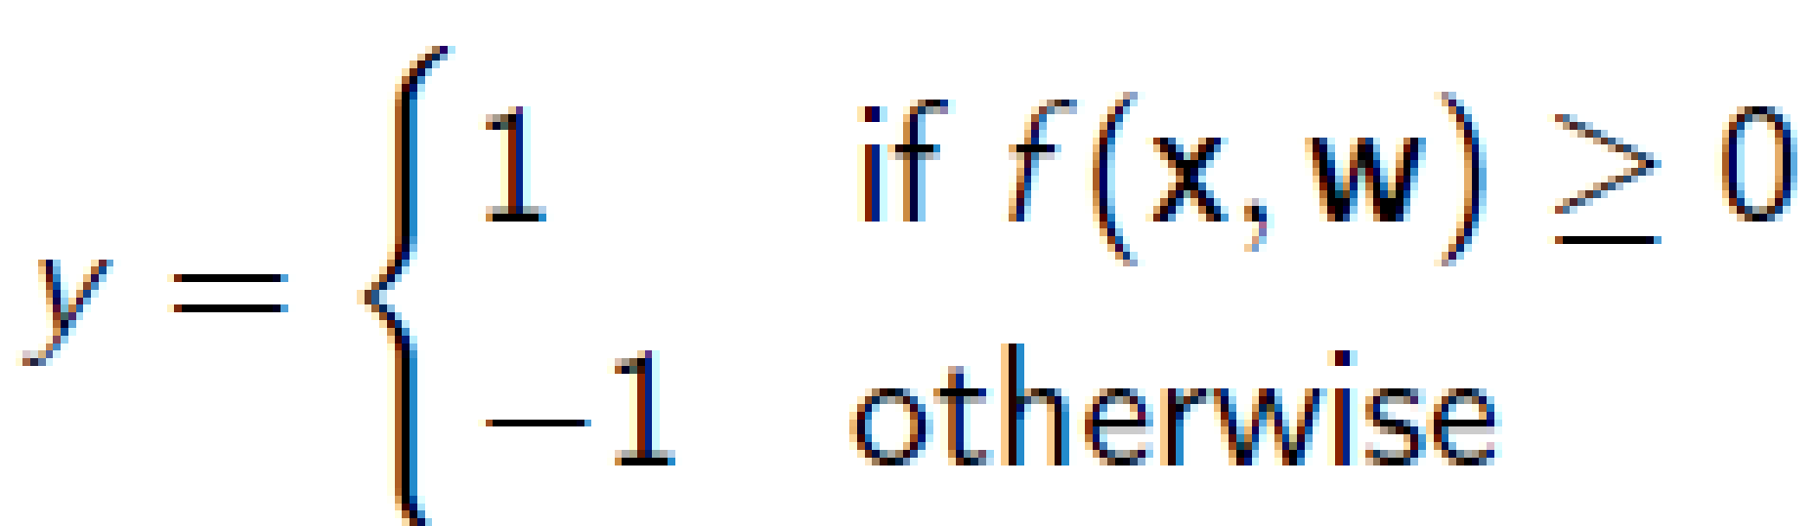
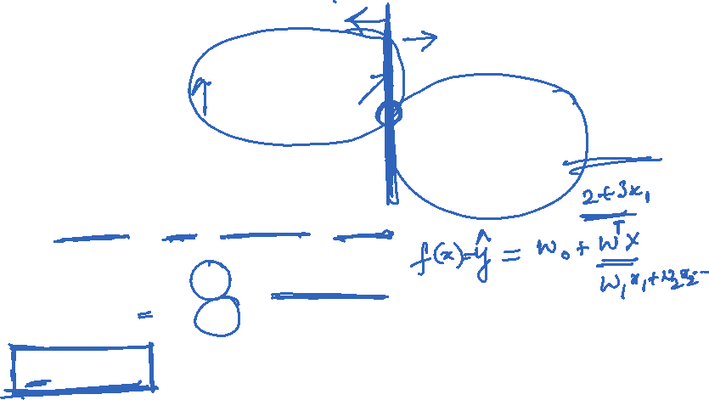
Decision Rules
Classifier:
f (x, w) = w_{o} + w^{T} x (linear discriminant function)
Decision rule is
Mathematically
y = sign(w₀ + w^{T} x)
This specifies a linear classifier: it has a linear boundary (hyperplane)
w₀ + w^{T} x = 0
A discriminant is a function that takes an input vector x and assigns it to one of K classes, denoted C_{k}.

Slide 19


Logistic Regression vs Least Squares Regression
(Yes) 1
Job Offered ?
(No) 0
CGPA or IQ
Failure due to adding a new point

Slide 20
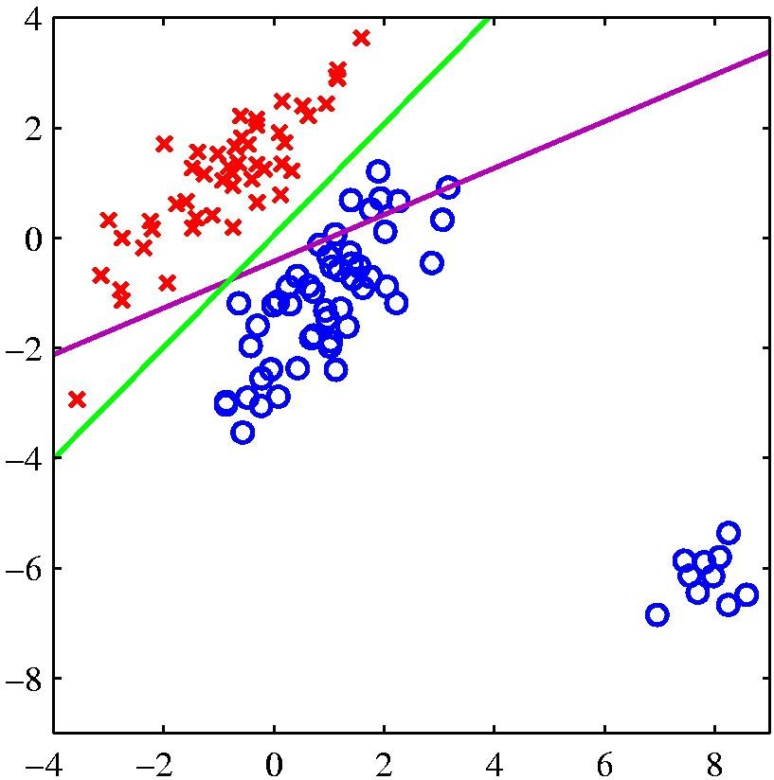
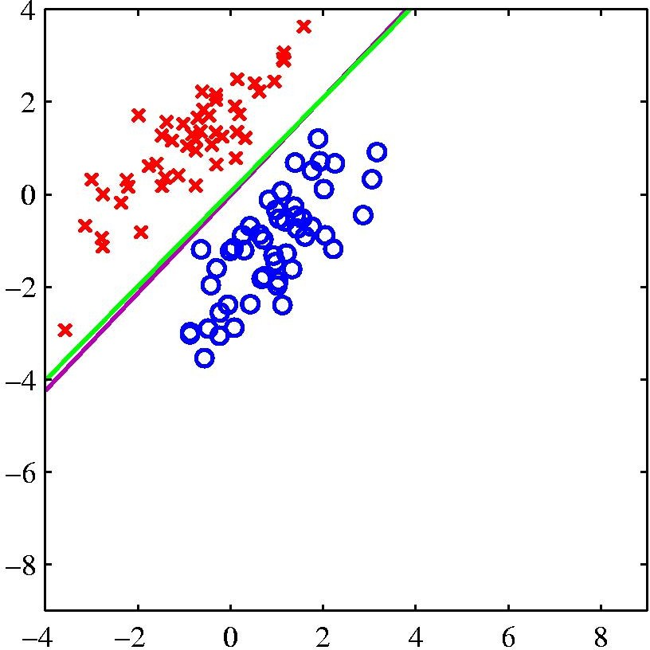
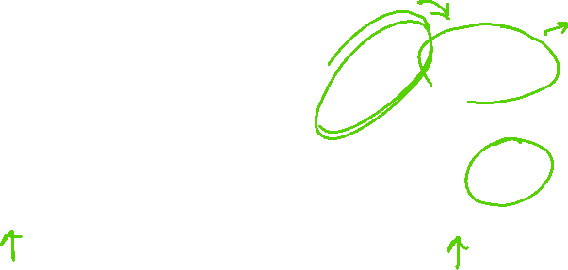
Logistic Regression vs Least Squares Regression
logistic regression
least squares regression
The right-hand plot shows the corresponding results obtained when extra data points are added at the bottom left of the diagram, showing that least squares is highly sensitive to outliers, unlike logistic regression.

Slide 21
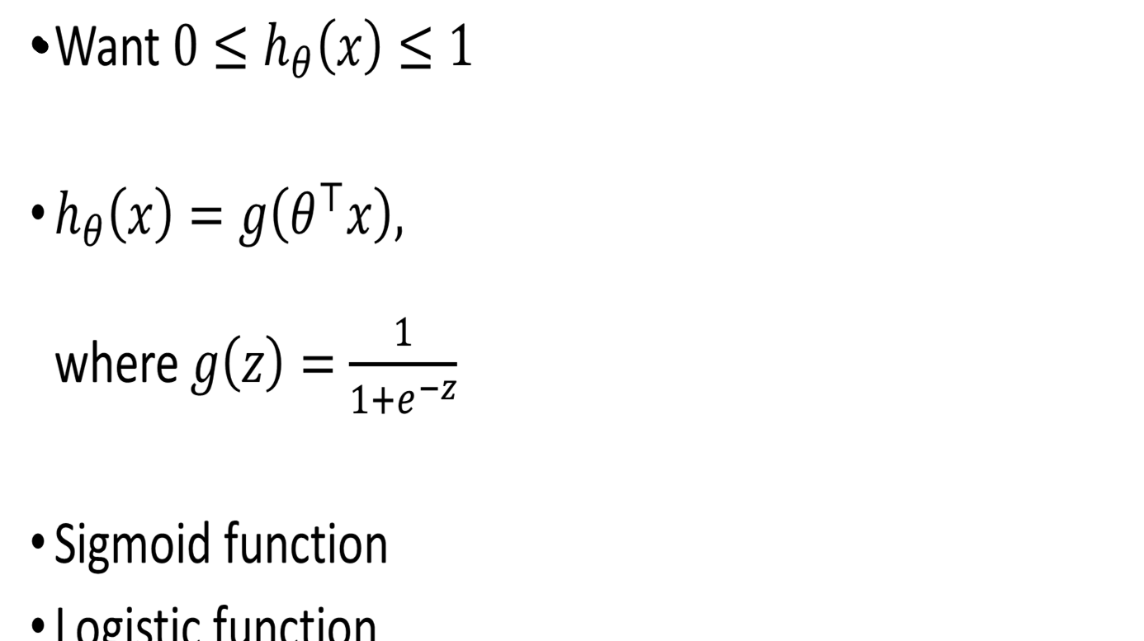

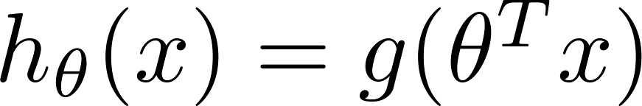
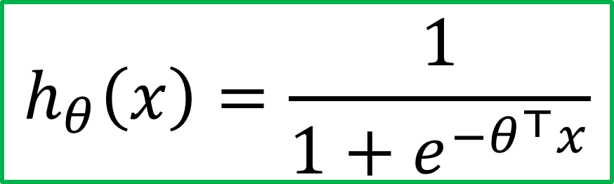
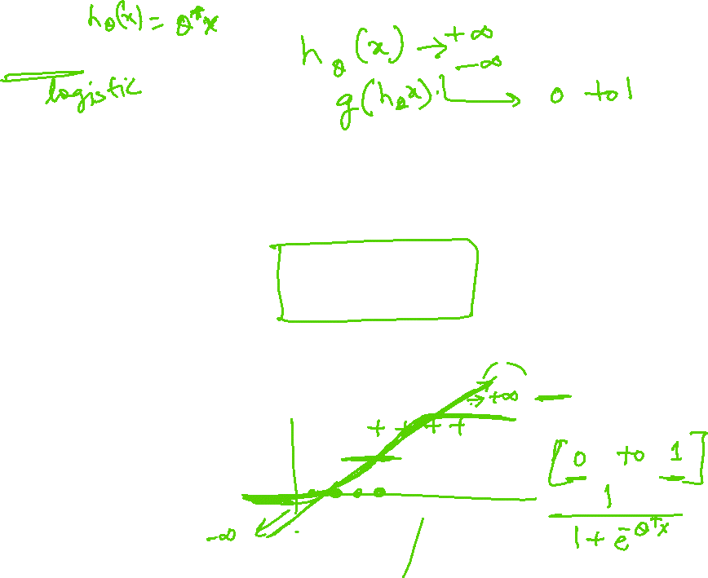
Sigmoid Function
Sigmoid/logistic function takes a real value as input and outputs another value between 0 and 1
That framework is called logistic regression
Logistic: A special mathematical sigmoid function it uses
Regression: Combines a weight vector with observations to create an answer

Slide 22
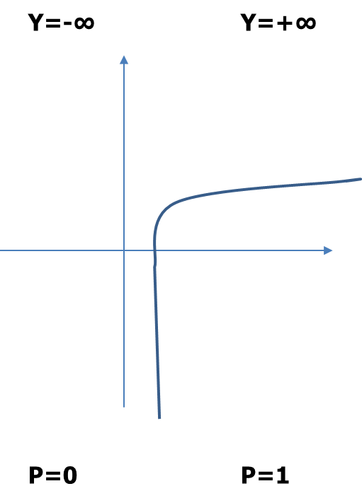
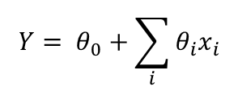
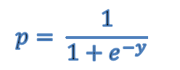
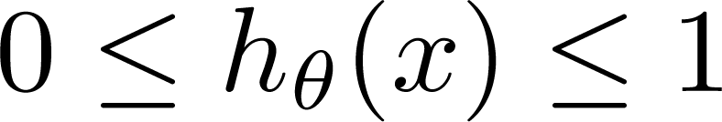
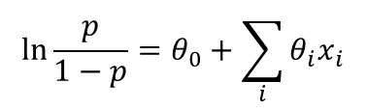
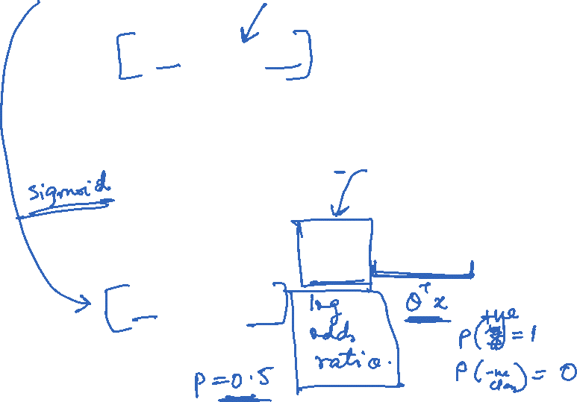
Classification: y = 0 or 1 h_{θ}(x) can be > 1 or < 0 What we need: Logistic Regression:
Logistic Regression vs Least Squares Regression
Another drawback of using linear regression for this problem

Slide 23
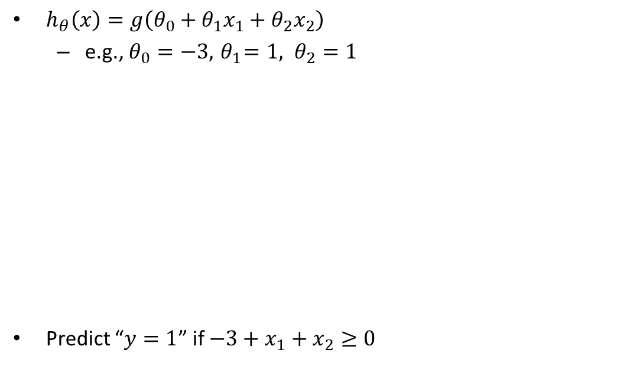
Logistic Regression – Sample Linear Boundary
At decision boundary output of logistic regression is 0.5
Figure depicts sample data points
Decision boundary
IQ
CGPA
Slide credit: Andrew Ng

Slide 24
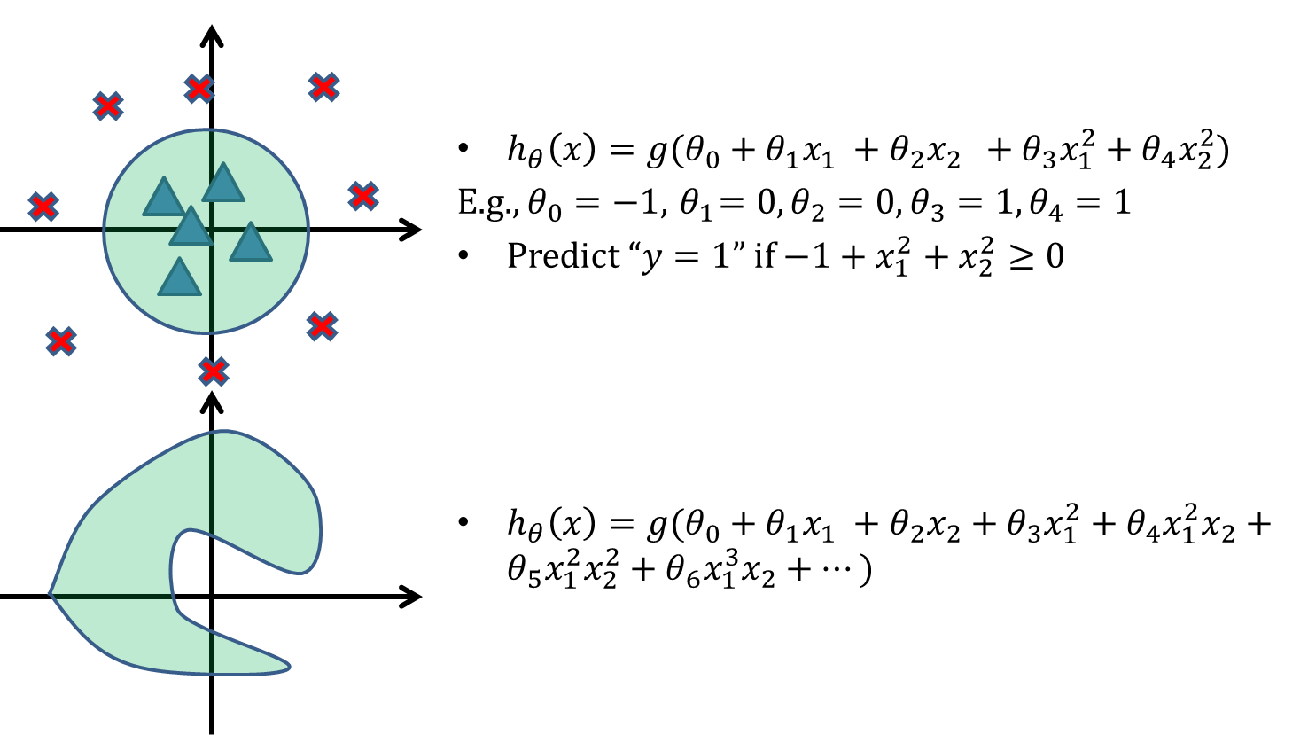
Logistic Regression – Sample Non-Linear Boundary
IQ
CGPA
Figure depicts sample data points
CGPA
IQ
Slide credit: Andrew Ng

Slide 25
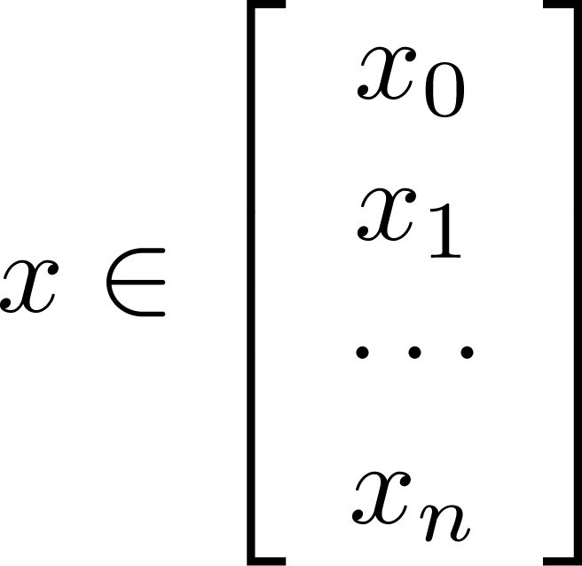
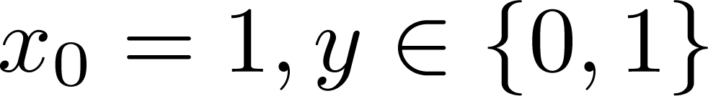
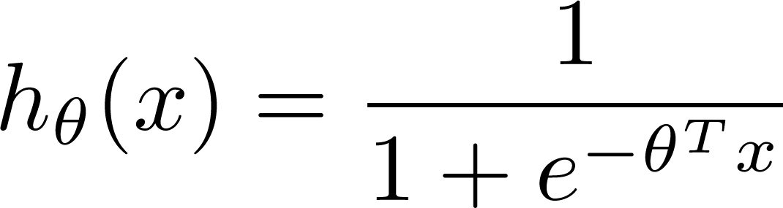

Learning model parameters
Training set:
m examples
How to choose parameters (feature weights) ?

Slide 26
Notion of Cost Function in Classification

Slide 27



Logistic Regression
Training set:
How to choose parameters (feature weights)?
“non-convex”
“convex”

Slide 28




Logistic regression cost function (cross entropy)
If y = 1
ie.,
Actual Value Job Offered = 1
Cost
0
1
Predicted Value
Job Offered = 1
Predicted Value
Job Offered = 0

Slide 29

Logistic regression cost function
If y = 0
ie.,
Actual Value
Job Offered = 0
Cost=0; If y=0 and h_{Ꝋ}(x)=0
Cost
0
Predicted Value
Job Offered = 1
Predicted Value
Job Offered = 0
1

Slide 30







Cost function
To fit parameters : Apply Gradient Descent Algorithm
To make a prediction given new :
Output :

Slide 31



Gradient Descent Algorithm

Slide 32






Gradient Descent Algorithm

Slide 33
Thank you !
Required Reading for completed session :
T1 - Chapter # 6 (Tom M. Mitchell, Machine Learning)
R1 – Chapter # 3,#4 (Christopher M. Bhisop, Pattern Recognition & Machine Learning) & Refresh your MFDS course basics

